Slide 1
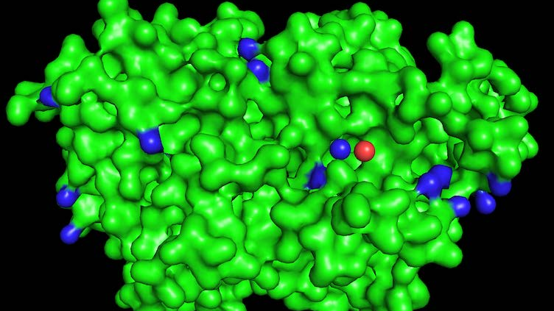
DeepPL
Predicting Protein – Ligand Interaction by using Deep Learning Models

Slide 2
Outline
Background
Preprocessing the data
Creating and training the model
Evaluating the model
Conclusion and bonus tip

Slide 3
Background

Slide 4
Protein-Ligand bindings
Ligands (e.g. medication) bind with proteins (e.g. DNA in our body) to perform biological processes
Predicting protein-ligand bindings is essential in drug discovery

Slide 5
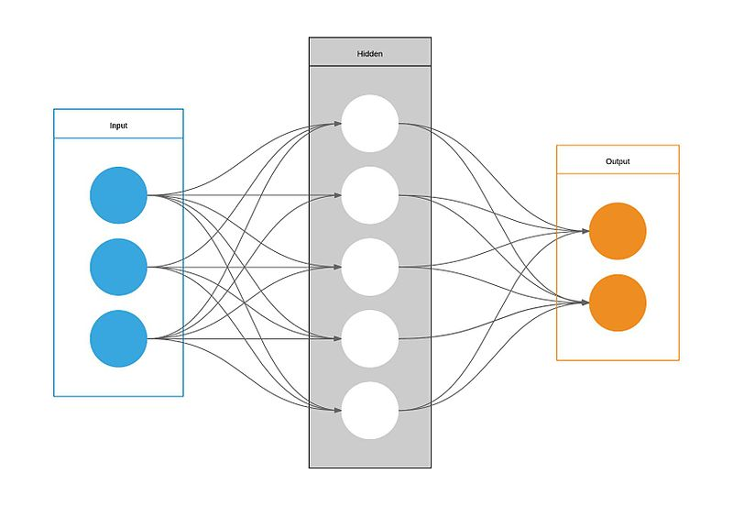
The task
Create a model that can accurately predict whether a given protein-ligand combination will bind
Protein data
Predictive Model
Preprocess
Predict
Bind/Not Bind
Ligand data
Evaluate

Slide 6
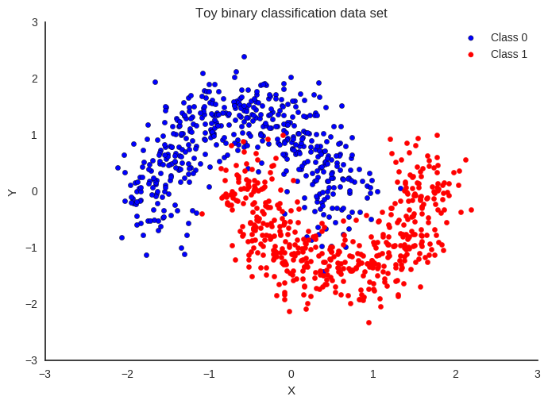
This is a binary classification problem!
Classifying the data into two groups
Bind/Not Bind
Predicting the probability of the target variable

Slide 7
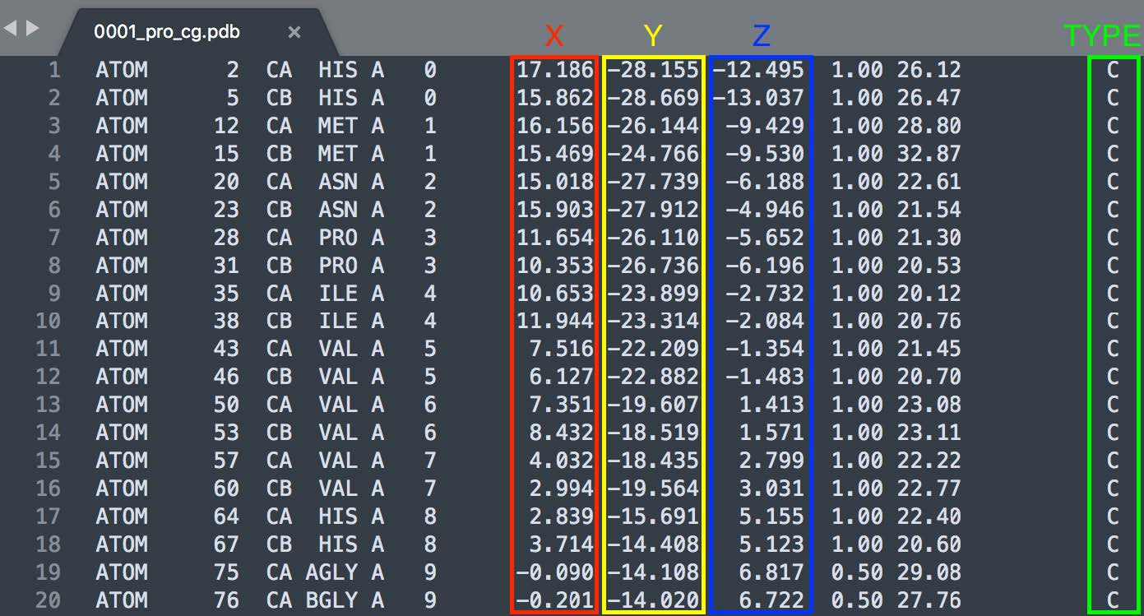
Provided dataset
3000 pairs of protein-ligand combinations
Molecule provided in .pdb format
Each molecule contains a list of atoms
x, y, z coordinate of each atom
Atom type (hydrophobic or polar)
3000 positive training examples
2999² negative training examples

Slide 8
Preprocessing the data

Slide 9
Dealing with varying input size
Protein can contain 100s to 1000s of atoms
Ligand contain much less atoms (usually less than 20, sometimes even 1)
Hard to design a neural network around varied input
Solution: Voxelization into a 3D grid

Slide 10
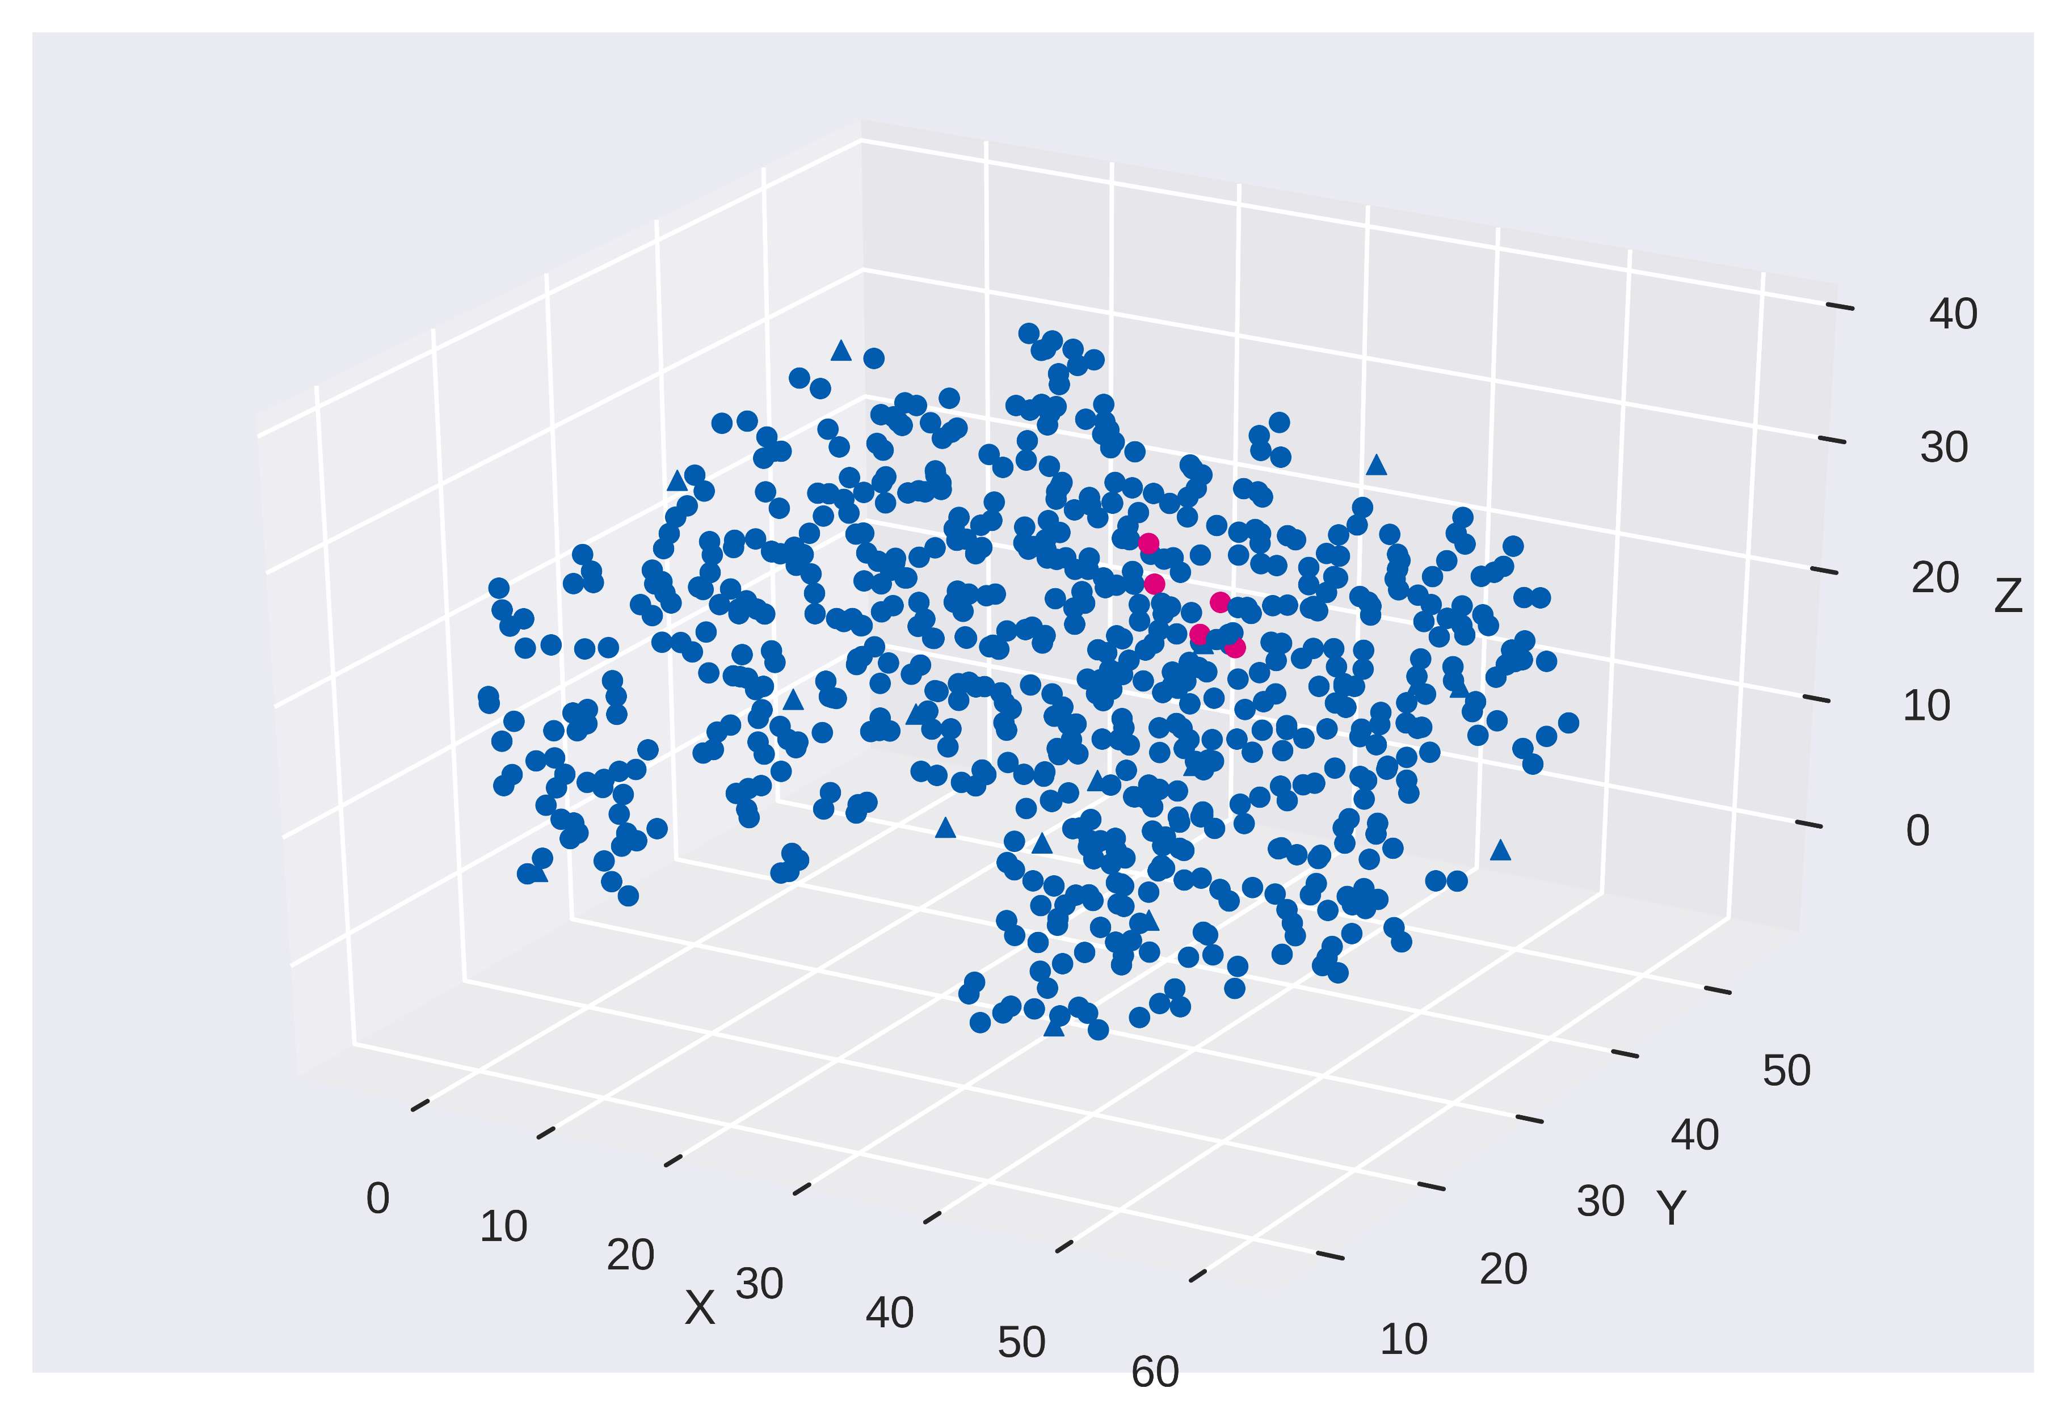
Voxelization of the data set
Protein atoms
Ligand atoms
Merge and center around ligand
Move to nearest grid point
Prune atoms outside box size
Atom Type
Molecule atom belongs to
Predefine max distance from center and grid resolution

Slide 11
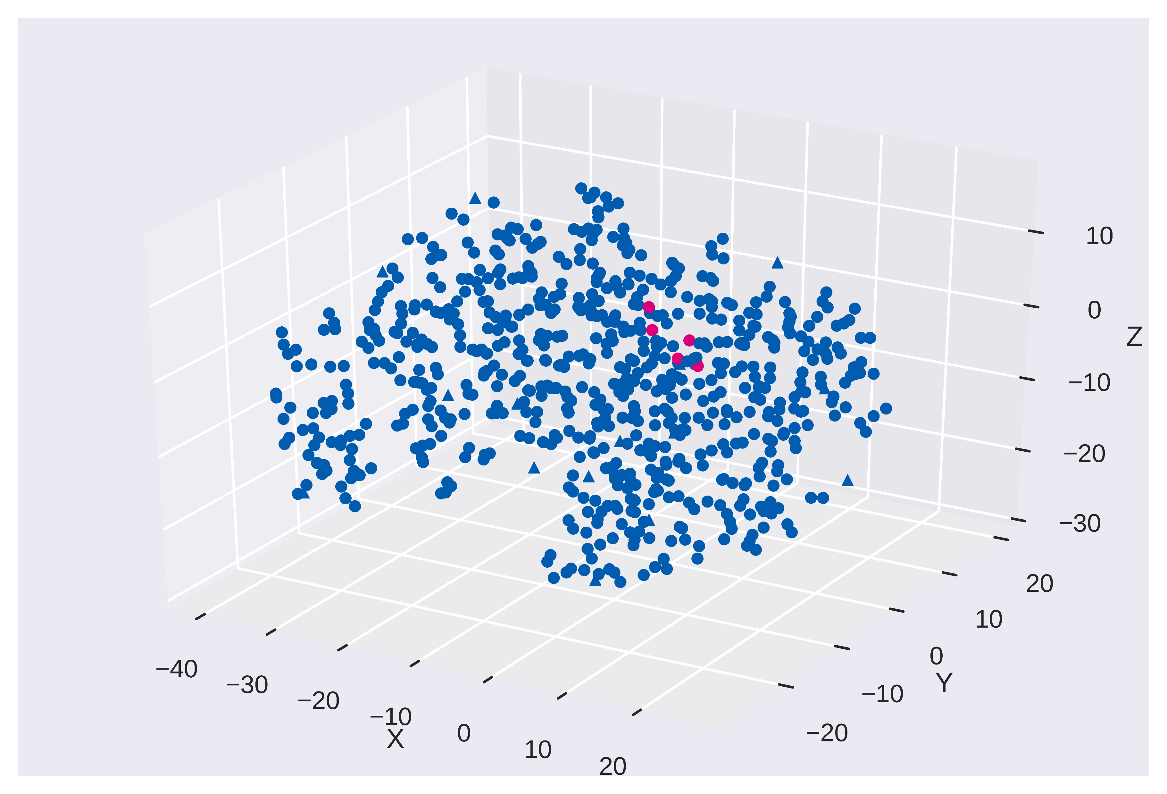
Voxelization of the data set
Protein atoms
Ligand atoms
Merge and center around ligand
Move to nearest grid point
Prune atoms outside box size
Atom Type
Molecule atom belongs to
coord_mat = coord_mat - np.mean(lig_atoms[:,:3].astype(np.float), axis=0)

Slide 12
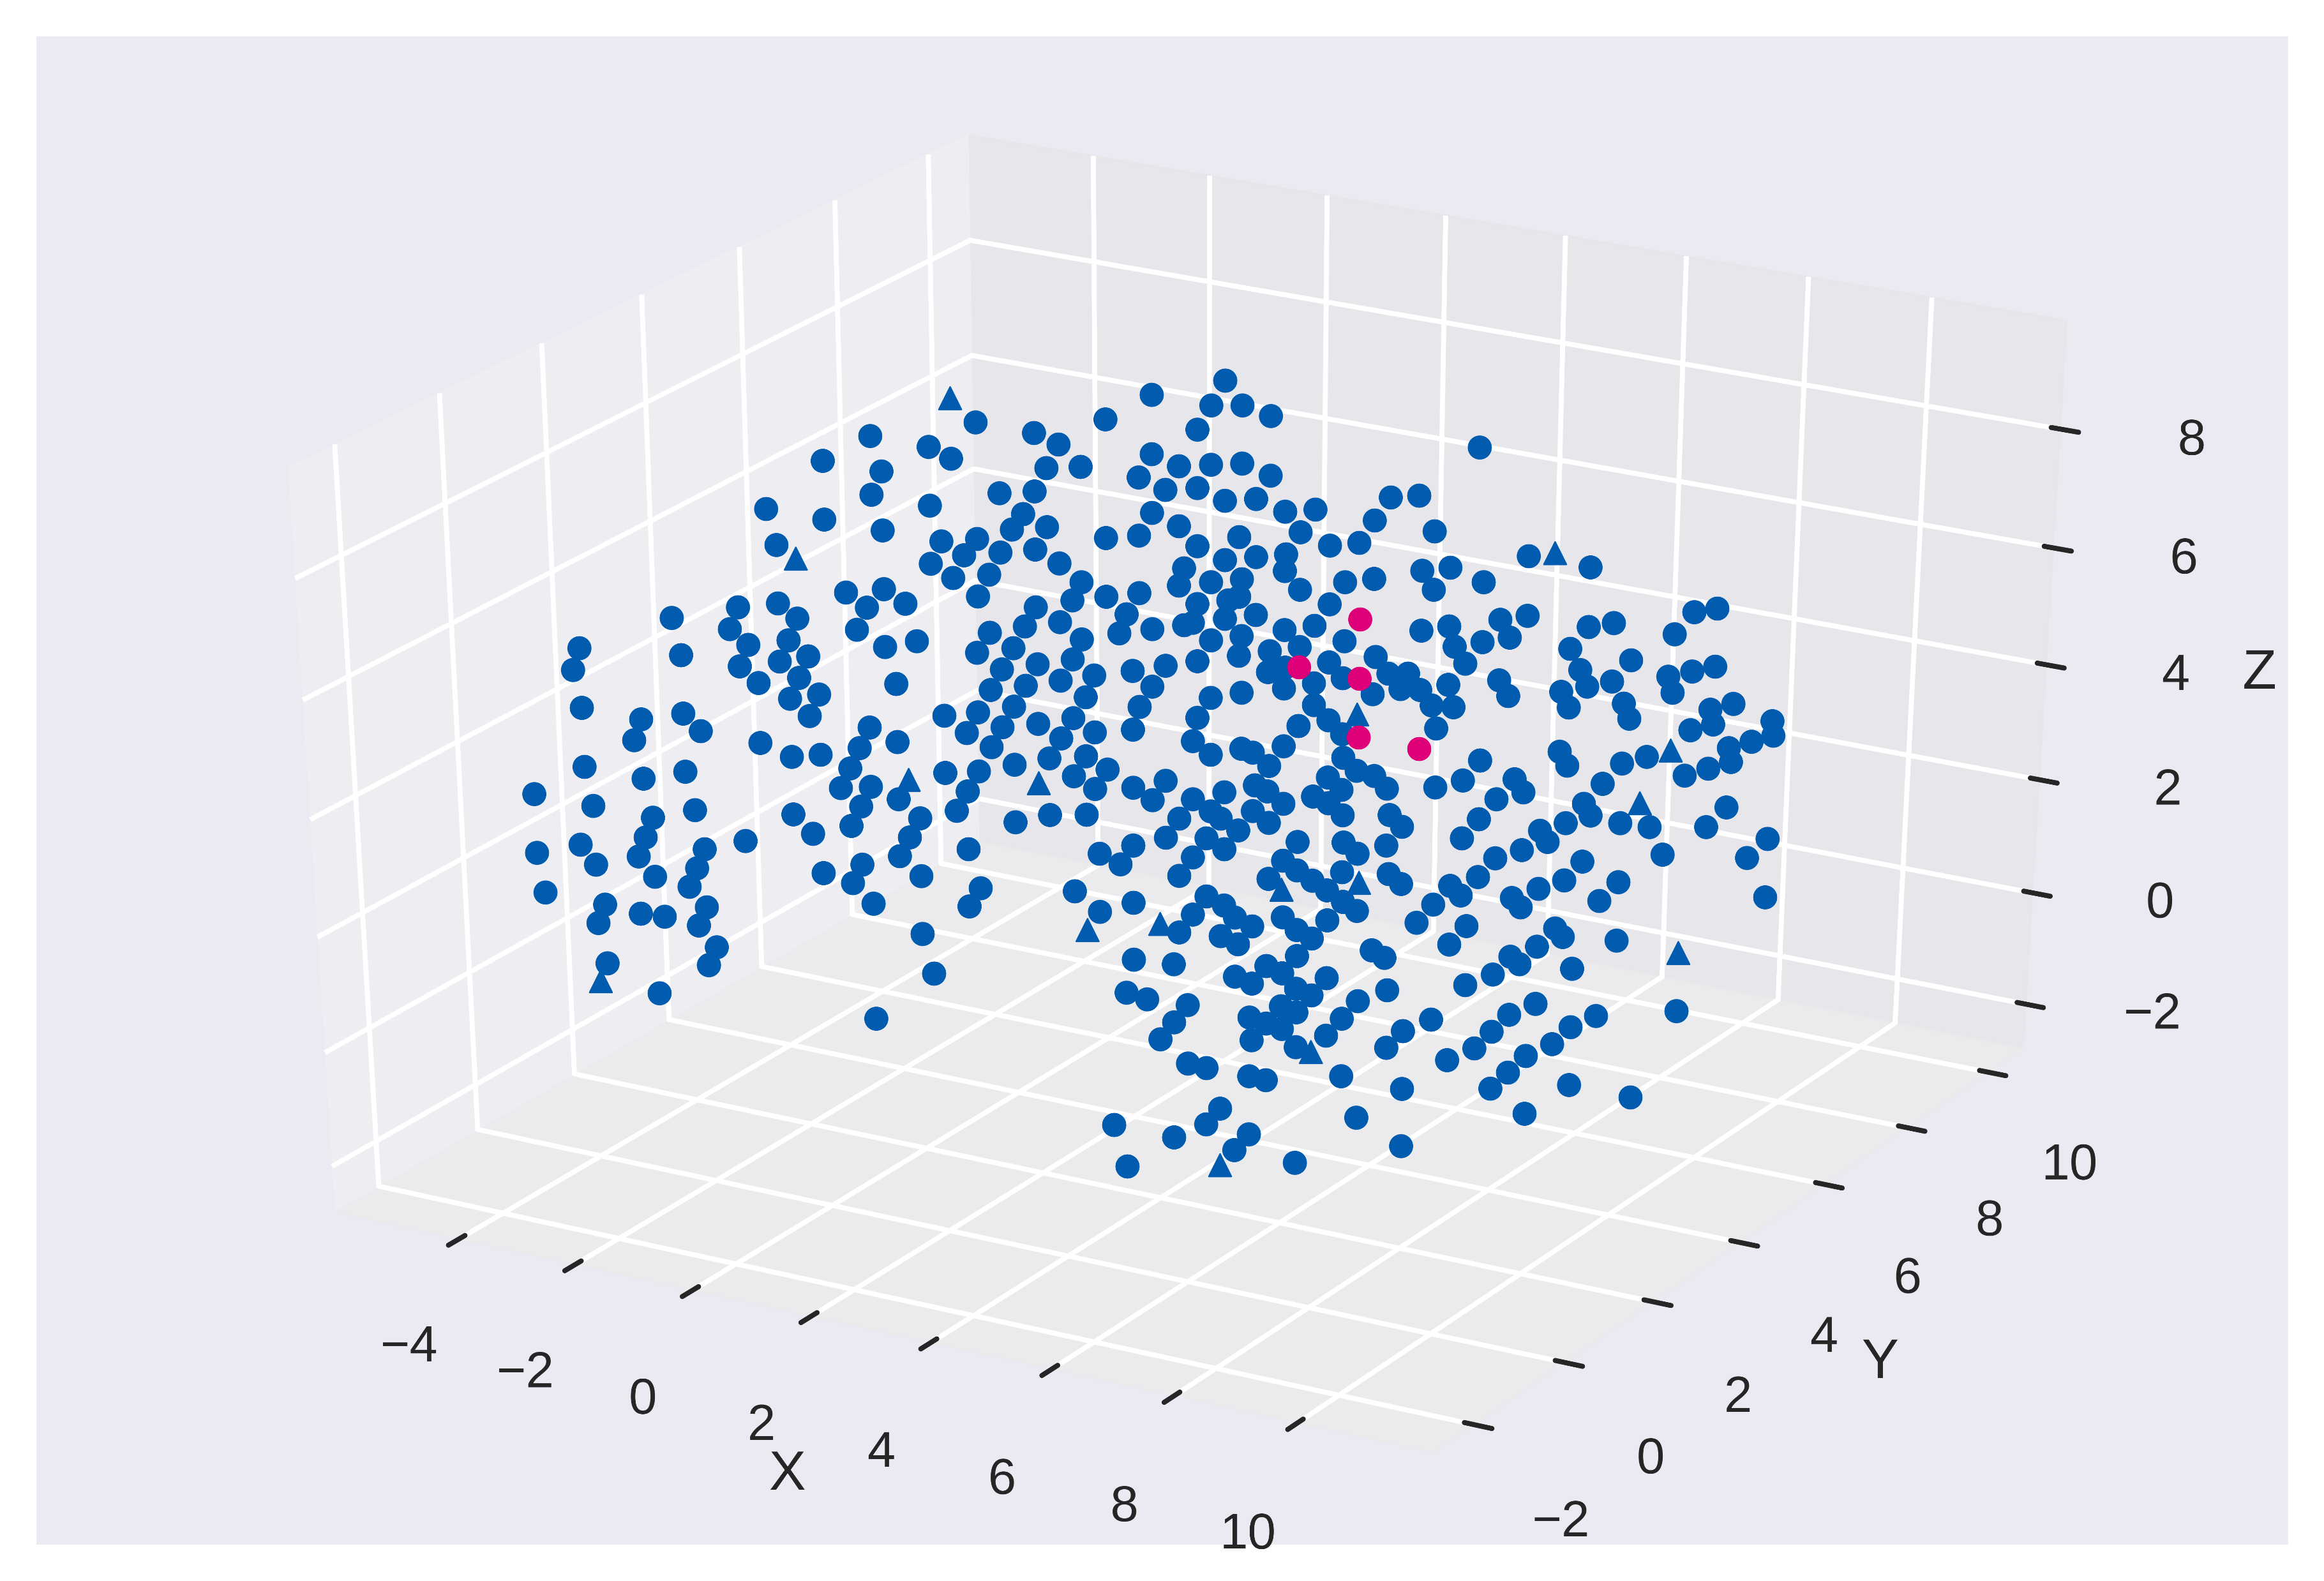
Voxelization of the data set
Protein atoms
Ligand atoms
Merge and center around ligand
Move to nearest grid point
Prune atoms outside box size
Atom Type
Molecule atom belongs to
atom_mat[:,:3] = ((atom_mat[:,:3] + max_dist) / grid_resolution).round()

Slide 13
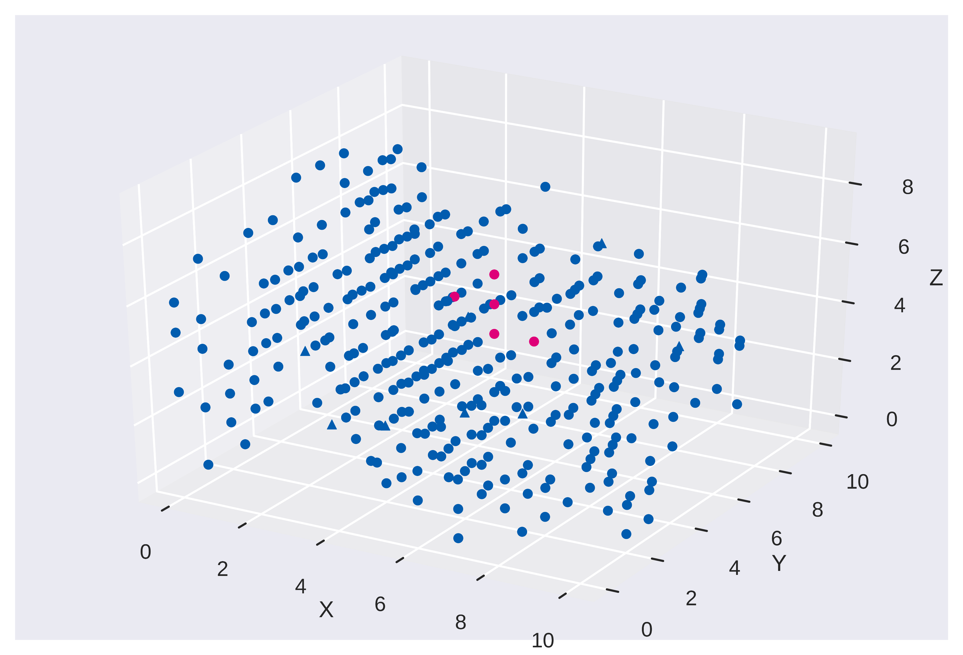
Voxelization of the data set
Protein atoms
Ligand atoms
Merge and center around ligand
Move to nearest grid point
Prune atoms outside box size
Atom Type
Molecule atom belongs to
in_box = ((atom_mat[:,:3] >= 0) & (atom_mat[:,:3] < box_size)).all(axis=1)
atom_mat = atom_mat[in_box]

Slide 14
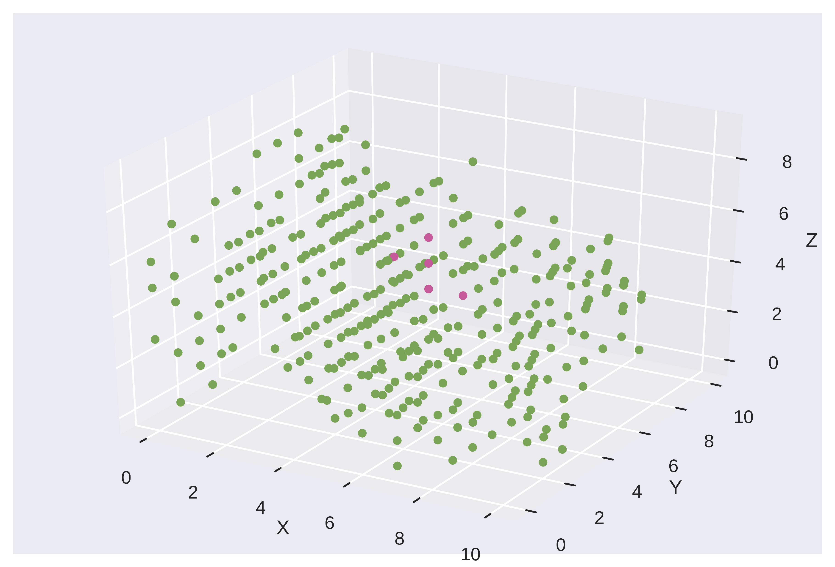
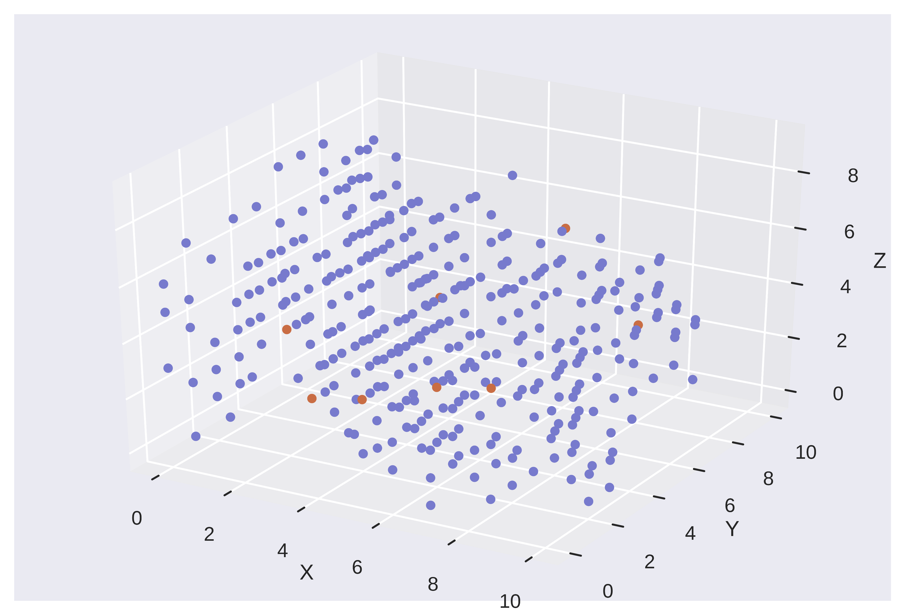
Voxelization of the data set
Protein atoms
Ligand atoms
Merge and center around ligand
Move to nearest grid point
Prune atoms outside box size
Atom Type: 128 if Hydrophobic, 256 if Polar
Molecule: 128 if Protein, 256 if Ligand
Sum overlapping atoms
Atom Type
Molecule atom belongs to

Slide 15
Choosing max distance and grid resolution
A high max distance and high grid resolution would theoretically allow the maximum amount of features to be captured in the input (*barring memory constraints)
In practice the neural network would fail to train
Input contains mostly 0, not enough data to fit on
Since all atoms are centered around the ligand, having a lower max distance is fine, tweak grid resolution until the network trains
Max distance: 20; Grid resolution: 4; Resultant input size: 11
Possible solution to using the full range of data using certain techniques?

Slide 16
Sparse Matrix: Memory saving technique
Voxel: A 3D matrix where points are represented by values in the matrix
Can simply be represented as a Sparse Matrix in COOrdinate format
Use toDense() function to retrieve the voxel
Process the data to higher dimensions before one-shot densifying
3D Voxel: (21, 21, 21)
2 feature voxels: (21, 21, 21, 2)
1000 samples: (1000, 21, 21, 21, 2)
Available libraries for multidimensional sparse matrix: pydata/sparse, TensorFlow’s Sparse Tensor

Slide 17
Creating and training the model

Slide 18
“Wide” Resnet
32k, 3x3
32k, 3x3
64k, 3x3
64k, 3x3
128k, 3x3
128k, 3x3
Input
Conv
Pool
Dense

Slide 19
“Wide” Resnet
32k, 3x3
32k, 3x3
64k, 3x3
64k, 3x3
128k, 3x3
128k, 3x3
Input
Conv
Pool
Dense
Conv
BatchNorm
32k, 3x3
Dropout
ReLU
Conv
Conv

Slide 20
“Wide” Resnet
32k, 3x3
32k, 3x3
64k, 3x3
64k, 3x3
128k, 3x3
128k, 3x3
Input
Conv
Pool
Dense
Sigmoid
1 if bind
0 if not bind

Slide 21
Training and validation data
All 3000 +ve examples
5400 training data
Full dataset
3000 random -ve examples
600 validation data

Slide 22
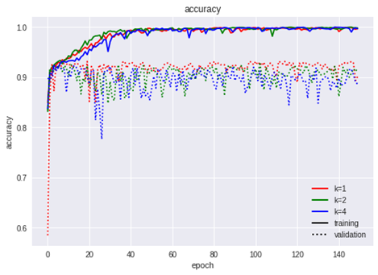
Experiments with width
Did not improve the model much
In fact showed signs of overfitting

Slide 23
Adam vs Adam+SGD
Adam is good at converging on a decent local optima without needing to tune hyperparameters too much
SGD is good at finding high-quality local minima but is slower and require more tuning of hyperparameters
Combine both: Run Adam for 100 epochs, run SGD with momentum and decay for another 100 epochs
Increase in accuracy from 92% to 95%
Use a larger batch size to increase learning rate

Slide 24
Modifying the first layer to train on sparse data
Recall that reducing grid resolution in the voxelization step makes the input more “dense” and thus the neural network is able to train on it
Equivalent to having a high resolution input and running it through a sum pooling layer to reduce the size
Instead of arbitrarily reducing the size, let the network learn what to keep
Use higher kernel size and dilation rate in the first convolution layer

Slide 25
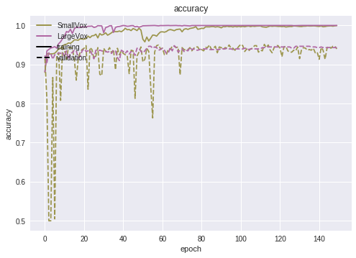
Modifying the first layer to train on sparse data
Small voxel
Max Distance: 20; Grid Resolution: 4
Kernel Size:3; Dilation Rate: 1
Final length: 9
Large voxel
Max Distance: 40; Grid Resolution: 2
Kernel Size: 17; Dilation Rate: 2
Final length: 9
Large voxel model successfully trained and produced similar results to small voxel model

Slide 26
Modifying the first layer to train on sparse data
Downside of this method:
Input is an extremely large voxel that needs to be generated
Would be much more efficient if input tensors stayed sparse throughout
Possible research topic?

Slide 27
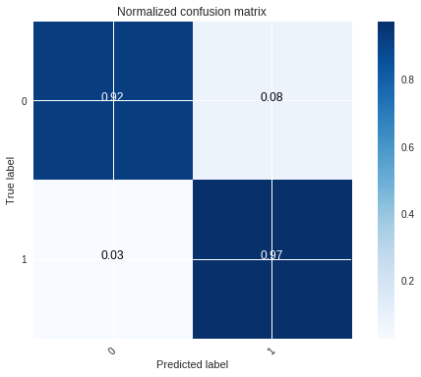
Training examples ratio
Training of network using 1:1 positive to negative training examples yield a high false positive rate

Slide 28
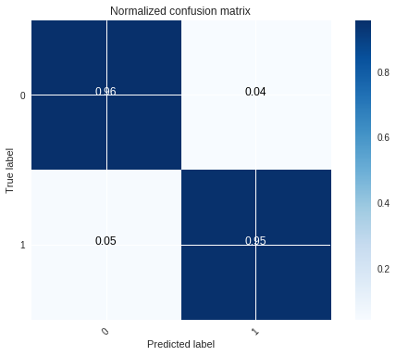
Training examples ratio
Using a 1:2 positive to negative training examples yield a lower false positive rate
Any higher ratios would reduce the true positive rate significantly

Slide 29
Dynamic generation of training examples
Previous training makes use of a pre-generated set of negative training examples
Only training on 2700/2699² possible negative training examples
Clearly training on more negative training examples is beneficial in reducing false positives
Attempt to sample as much negative training examples as possible by regenerating them at the start of each epoch

Slide 30
Dynamic generation of training examples
2700 training pairs
2700 positive training examples
Full dataset
5400 training examples
(Generated at the start of each epoch)
300 validation pairs
2700 negative training examples

Slide 31
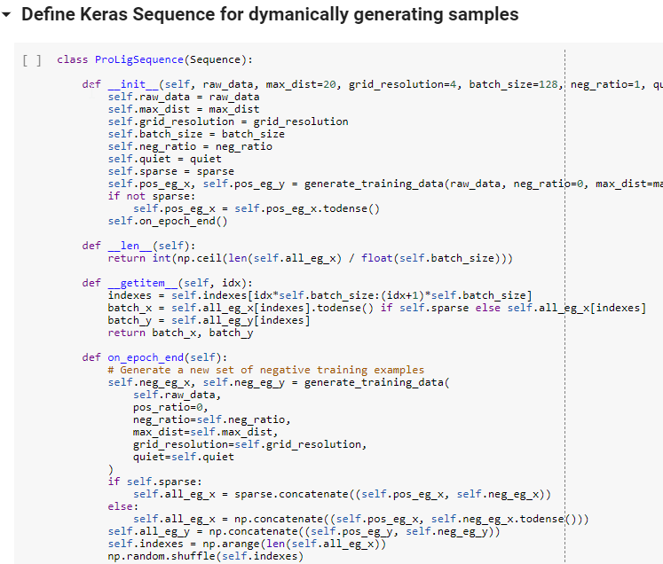
Implementing in Keras
Define a Keras Sequence object that returns a batch of training examples when __getitem__ is called
Use fit_generator() instead of fit() when training your model
Adam used throughout since the loss landscape is constantly shifting

Slide 32

Dynamic generation results
Validated on dataset with 1:10 positive to negative validation examples
Is able to reduce false positive rate while maintaining true positive rate

Slide 33

Separate your training and validation dataset!
This result is from a model where the generation of training and validation data were from the same dataset

Slide 34
Evaluating the model

Slide 35
Accuracy is not accurate
Accuracy is the number of correct predictions/total number of examples
Does not reveal anything about predicting positive and negative training examples correctly
Can be skewed if the underlying dataset is skewed
E.g. Model has high false negative rates but the dataset has few positive examples

Slide 36
Confusion Matrix
Breaks down the rates of each prediction, great for comparing between models at the end

Slide 37

Precision, Recall, F1 Score, Matthew’s Correlation Coefficient
Precision: Number of true positives/Total number of returned positives
Recall: Number of true positives/Total number of actual positives
F1 Score: Harmonic mean of precision and recall
Matthew’s Correlation Coefficient: Measure of quality of binary classifier from -1 to +1
+1: Perfect Prediction
0: Random Prediction
-1 Total disagreement between prediction and observation

Slide 38
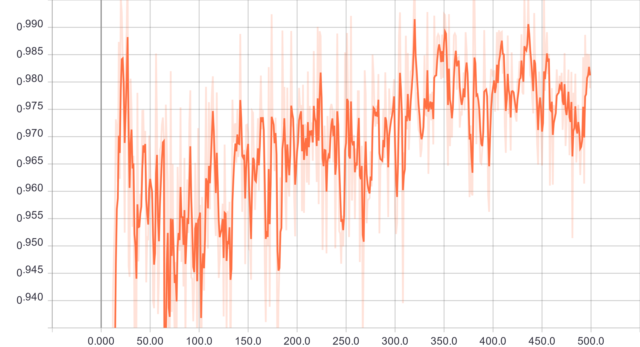
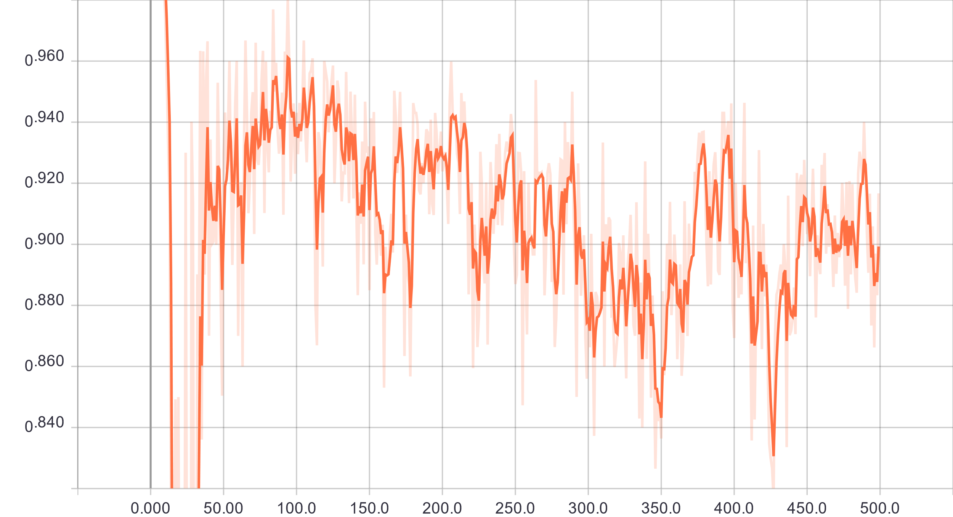
Metrics in practice
Validation Precision
Validation Recall

Slide 39
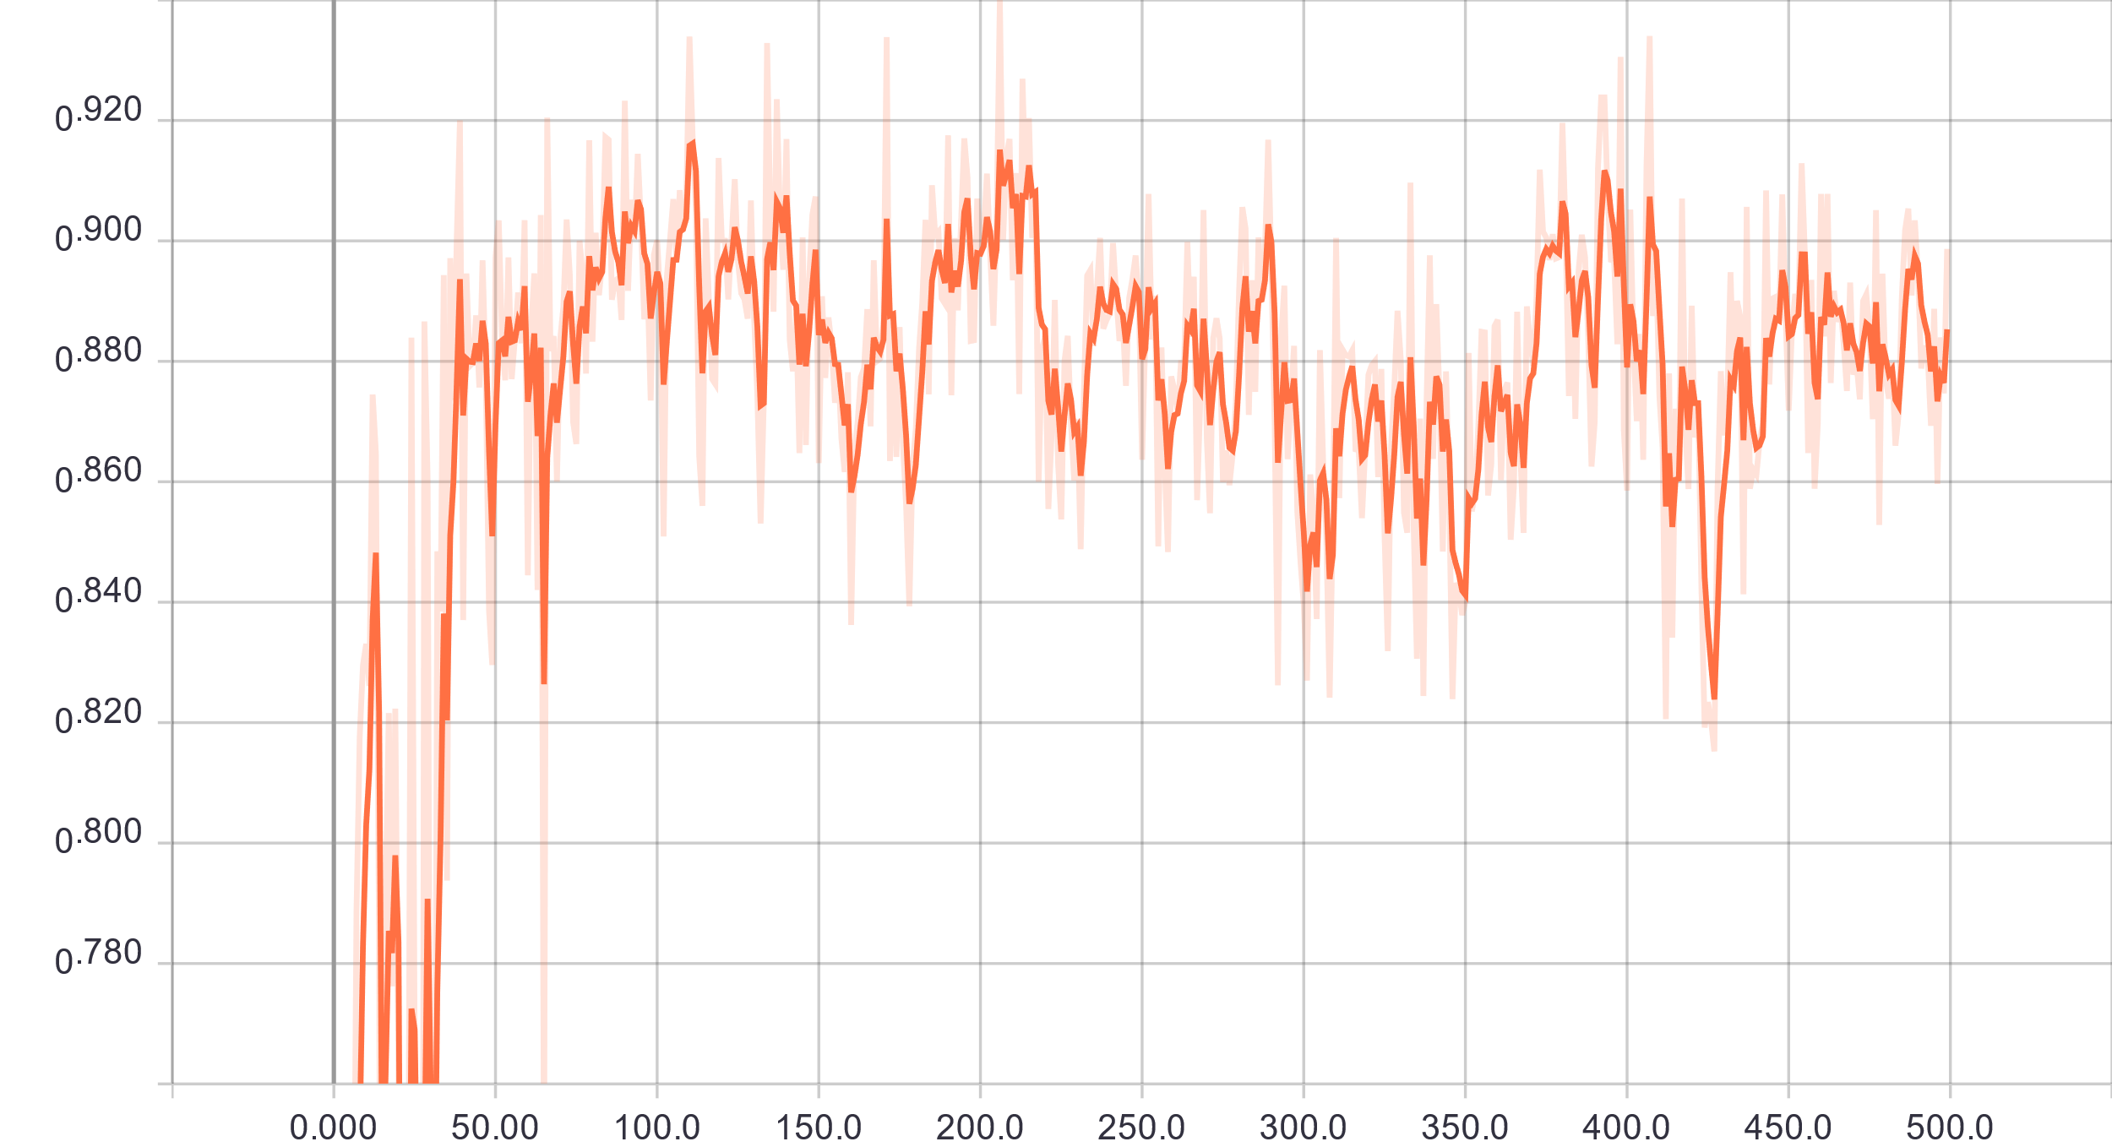
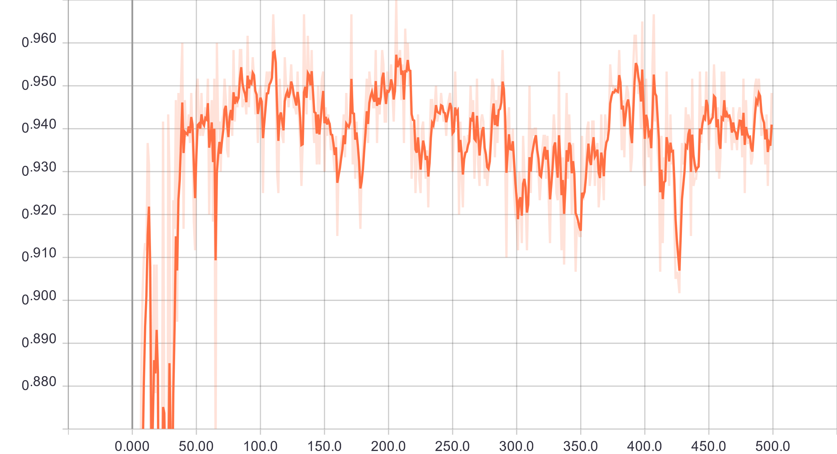
Metrics in practice
Validation MCC
Validation Accuracy

Slide 40
Top 10 ligands?
Given n proteins and ligands, for each protein return the top 10 ligand that is likely to bind with the protein
Number of protein with correct ligand in the top 10 / Total number of proteins
Let’s say we have a model with 100% true positive rate and 1% false positive rate
n = 1000: The model returns 10 false positives for every protein which might push out the true positive
n = 10000: The model returns 100 false positives for every protein. The true positive is now even less likely to be in the top 10
As n approaches infinity, the accuracy of any model except a literally perfect one approaches 0

Slide 41
Conclusion

Slide 42
Identify the type of problem so you can make use of the correct metrics
Make sure you separate your training and validation dataset
Make use of sparse matrices and tensors
Make use of different optimizers throughout the training
If the dataset is extremely large, randomly sample the dataset

Slide 43
Bonus Tip: Tensor Processing Unit
Google Colab has had free GPU (Tesla K1) for everyone for a while
Runtime per epoch (batch size 500): 40s
They recently opened up access to their TPU servers within Colab
Runtime per epoch (batch size 1024): 3-5s
Generating the data took longer than to fit the model
Not many changes required to your Keras code to get it to work on the TPU
Download my code:
https://whluo.me/DeepPL/TPUDeepPL.ipynb

